Slide 1

Project Review – 6
Department : Electronics and Communication Engineering
Project Title : Visual Cryptography Based Watermarking to Detect and Localize Image Forgery
SUPERVISOR : Mr. V PRASANNANJANEYA REDDYREDDY, Professor(ECE)
S.NO | Name | Roll No. | Branch & Section
1. | K.Gayathri Naga Bhanu | 21951A0453 | ECE-A
2. | N. Harini | 21951A0458 | ECE-A
3. | G. Dineeth Udbhav | 21951A0448 | ECE-C

Slide 2
Introduction
Nowadays, millions of images and videos are processed and transmitted by people over the internet. Images have been used heavily as evidence in law enforcement, the courts, science and medical healthcare . The availability of editing software tools makes it very easy to insert, delete, edit and modify any part of the images. Hence, it is very necessary and imperative to develop forgery detection tools to identify different kinds of malicious modifications of images . Resampling, image retouching, image copy paste and splicing are the main known modifications of digital images. Hence, image integrity authentication, digital signatures, hash codes, watermarking and cryptography are the basic tools which are used to detect and localize the forgeries in the digital images . There are two types of image authentication techniques: active and passive . The active techniques use the watermarks embedded inside the image to check the integrity while the passive techniques do not use any prior knowledge about the image to detect forgery .

Slide 3
Abstract
The usage of images in different fields has increased dramatically, especially in medical image analysis and social media. Many risks can threaten the integrity and confidentiality of digital images transmitted through the internet. As such, the preservation of the contents of these images is of the utmost importance for sensitive healthcare systems. In this paper, the researchers propose a block-based approach to protect the integrity of digital images by detecting and localizing forgeries. It employs a visual cryptography-based watermarking approach to provide the capabilities of forgery detection and localization. In this watermarking scheme, features and key and secret shares are generated.

Slide 4
Problem Statement
Digital images are ubiquitous in today's digital landscape, often serving as crucial evidence in various domains such as forensics, journalism, and authentication. However, the ease of access to sophisticated image editing tools has led to a surge in image forgery incidents, where the integrity and authenticity of digital images are compromised. Detecting and localizing such forgeries pose significant challenges due to the ever-evolving nature of forgery techniques and the potential for subtle alterations that evade detection.
Existing methods for image forgery detection often rely on digital watermarking techniques, which embed invisible or semi-visible marks within the image to identify tampered regions. However, these methods face limitations in robustness and security, as attackers continuously develop sophisticated strategies to remove or alter watermarks without detection

Slide 5
Objectives:
Objectives
Develop a comprehensive understanding of existing image forgery detection techniques, including digital watermarking methods and their limitations.
Develop a comprehensive understanding of existing image forgery detection techniques, including digital watermarking methods and their limitations.
Design and implement a novel visual cryptography-based watermarking algorithm capable of embedding authentication information into digital images without perceptible degradation in quality.
Evaluate the robustness of the proposed watermarking approach against common forgery attacks, including copy-move, splicing, and tampering with compression.
Develop algorithms and methodologies for accurately detecting and localizing forged regions within watermarked images, utilizing the embedded watermark as a hidden authentication signal.

Slide 6
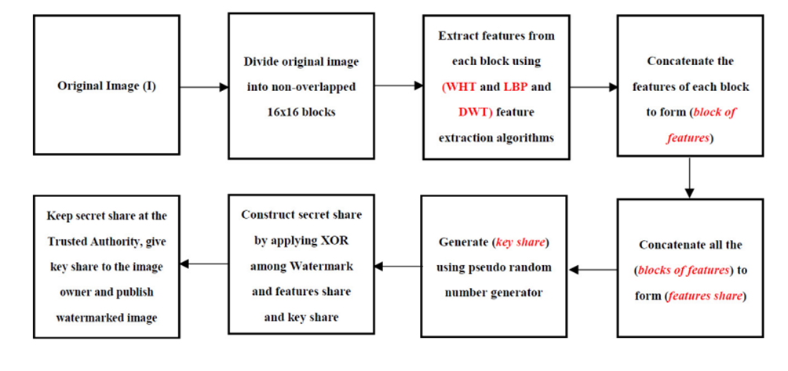
Fig: 1 Block diagram of the proposed method: Shares construction phase

Slide 7
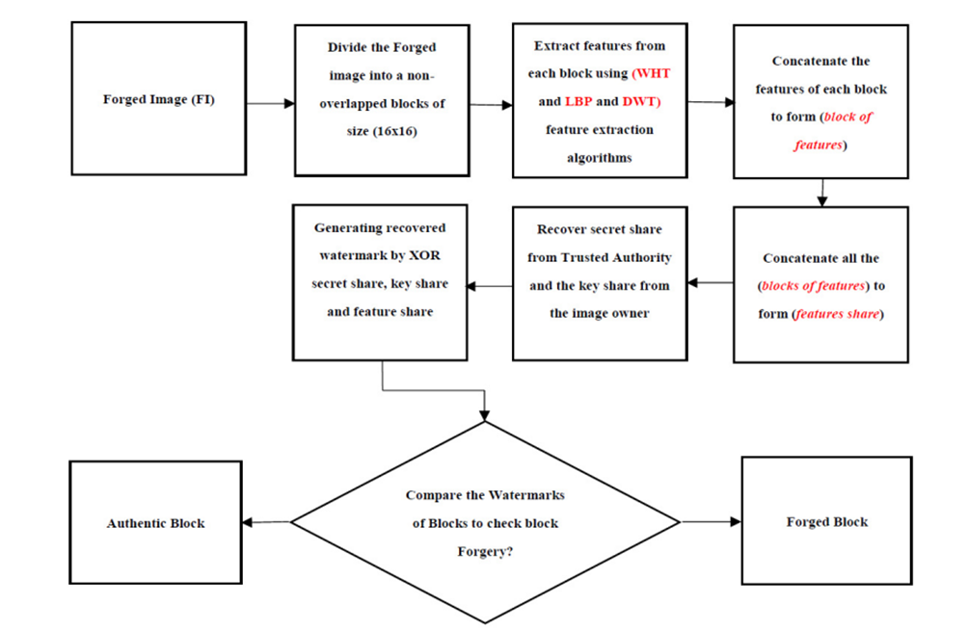
Fig: 2 Image forgery verification

Slide 8


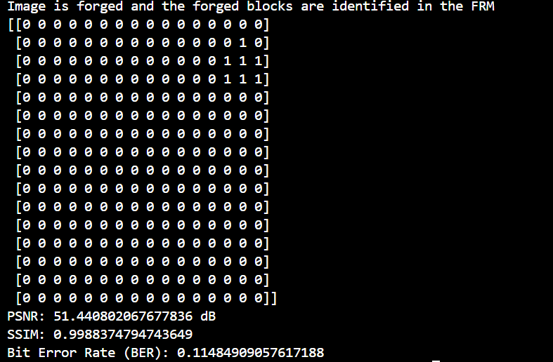


Results
Original image:
Watermarked image:
Final result:
Forged image:
Watermark image:

Slide 9
Interpretation of the results:
PSNR (Peak Signal-to-Noise Ratio): 51.44 dB – This is a high value, suggesting that the changes between the original and the forged image are minimal and almost unnoticeable to the human eye.
SSIM (Structural Similarity Index): 0.9988 – The SSIM is very close to 1, indicating that the structure of the image has been well preserved, despite the forgery.
BER (Bit Error Rate): 0.1148 – This relatively low value implies fewer bit-level errors between the original and the watermarked image compared to the first case, where BER was significantly higher.

Slide 10
THANK YOU!!!

